Slide 1
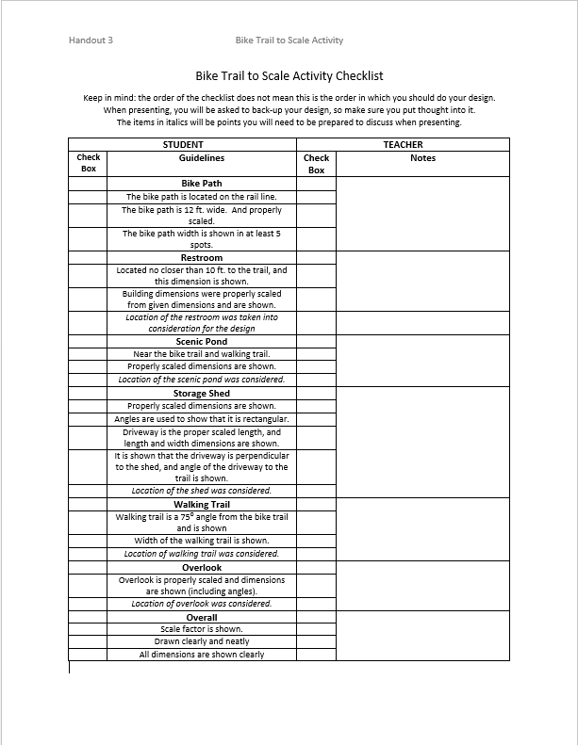
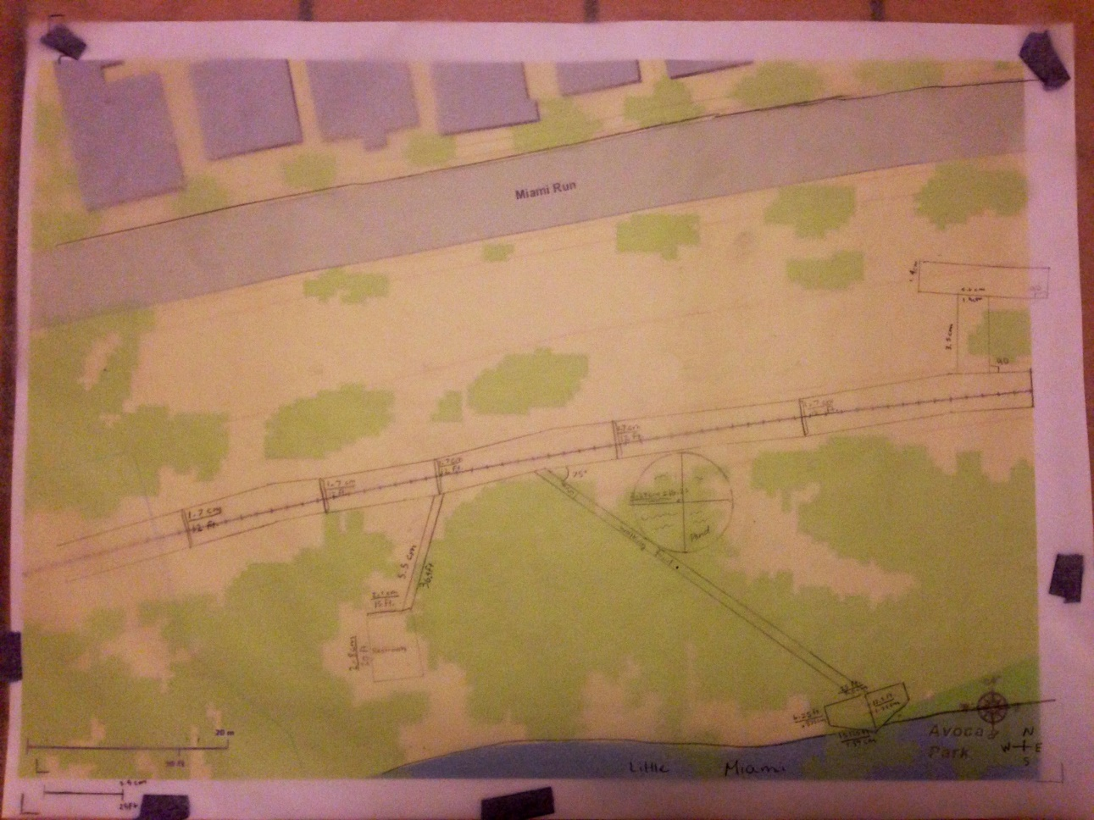
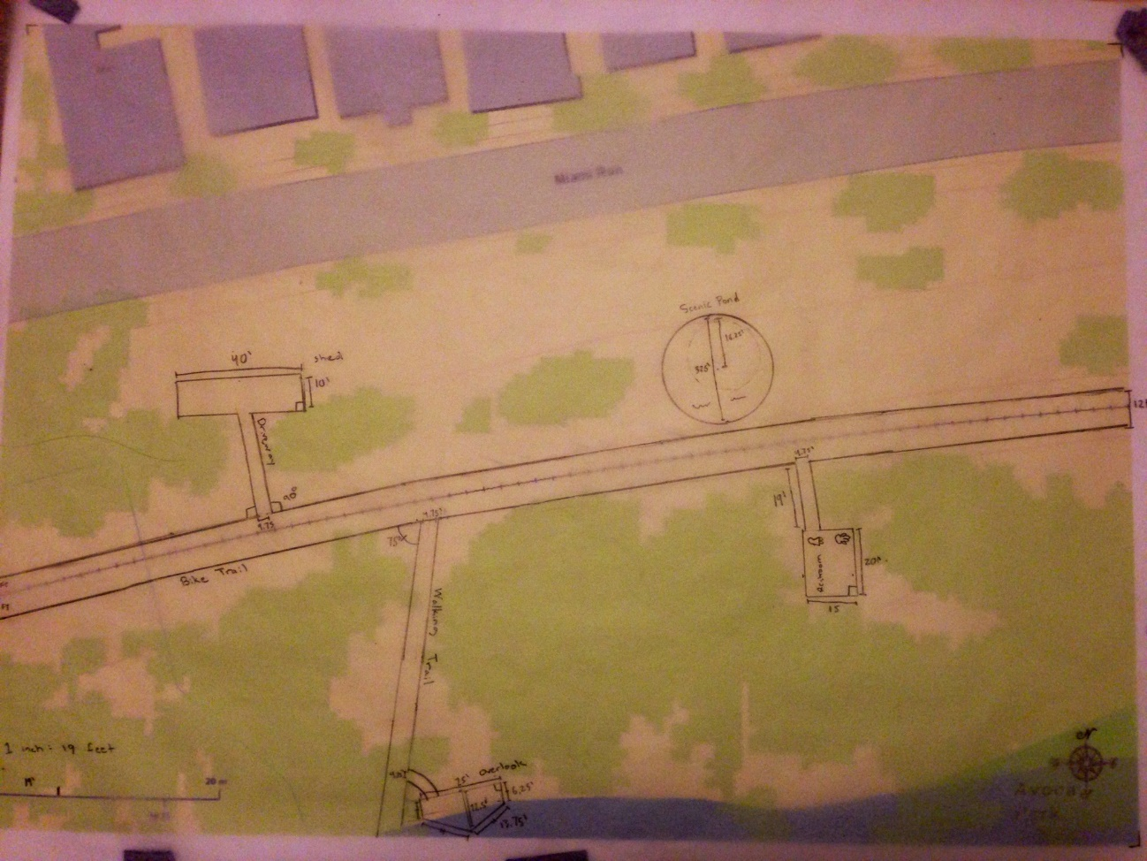
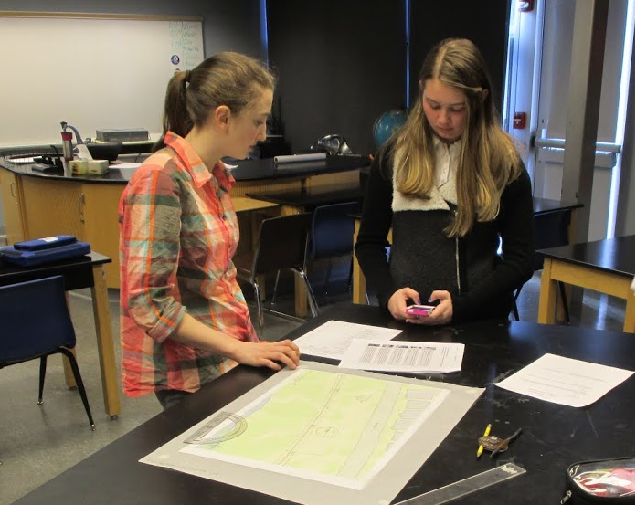
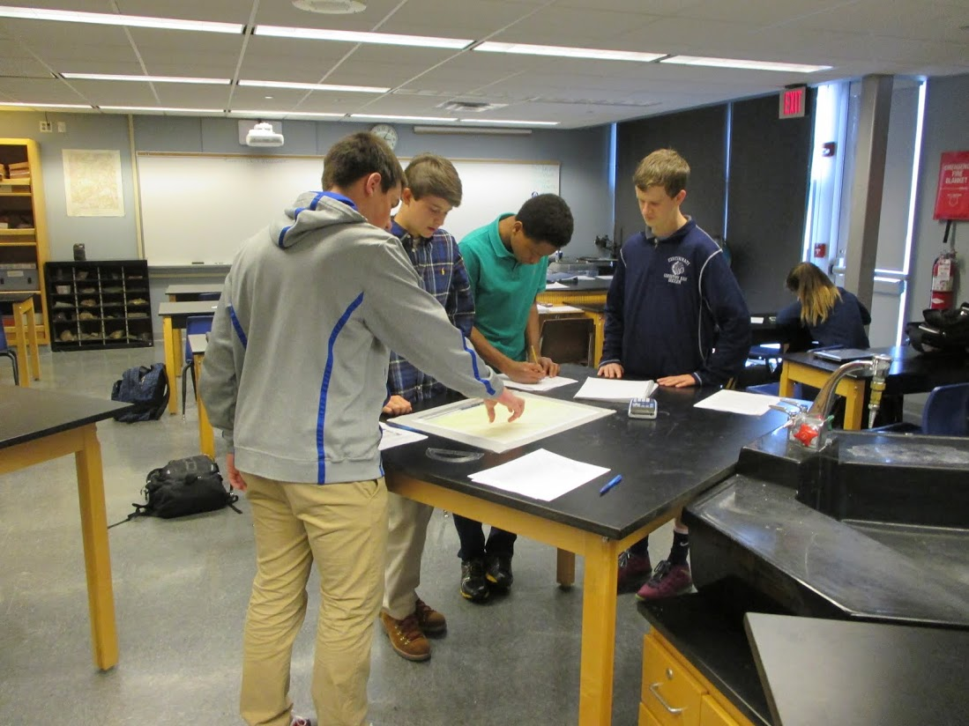
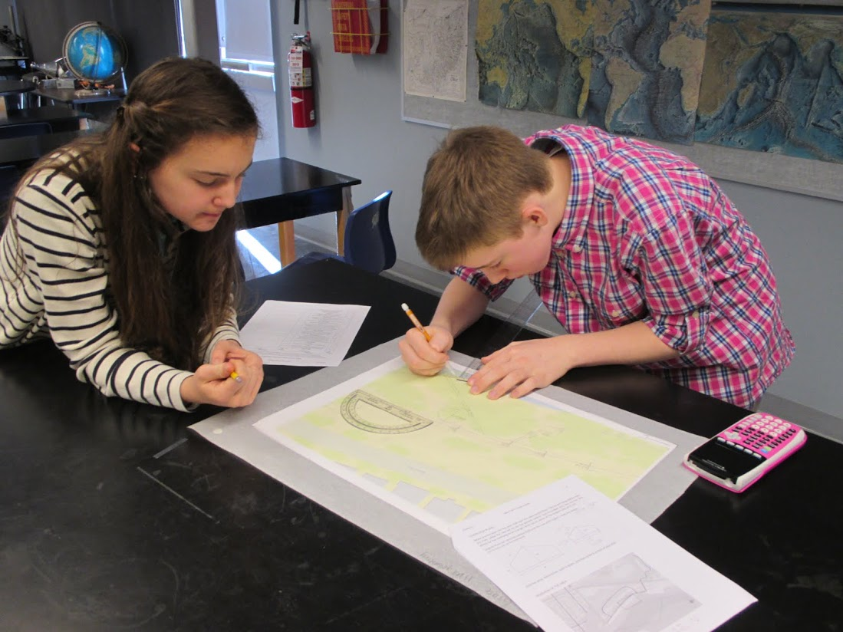
Bike Trail to Scale Kayla Quinter Cincinnati Country Day School, Honors Geometry (9)
RET is funded by the National Science Foundation, grant # EEC 0808696.
Unit Overview
Unit Activity Implementation
Student Work
Topic: Similar Polygons
Standards:
CCSS.Math.Content.HSG-MG.A.3
Apply geometric methods to solve design problems.
CCSS.Math.Content.HSG-SRT.A.1b
The dilation of a line segment is longer or shorter in the ratio given by the scale factor.
The students were asked to design a bike trail following given “codes and standards” while taking into consideration cost, topography, social impacts, and environmental impacts.
Day 1:
Pre-assessment, presentation
of scaling using in engineering
applications, and discussion
about the activity. Day 2:
Students were given a full class period to complete their design. Day 3:
Presentation of the team designs, post- assessment and discussion.
Assessment Results:
Impact on Student Learning
Activity Structure
Number of Students that Turned in Post Activity Homework
Title: Bike Trail to Scale
Guiding Questions:
What is a scale as used in drawings and maps?
How do you determine the scale ratio between two similar shapes?
How do you use the scale ratios and proportions to find dimensions of similar shapes?
How can you use a given scale to create a blueprint or scaled drawing?
Where can you find scales being used?
Objectives: Students should be able to…
Identify the scale ratio when given a scaled drawing.
Identify the scale ratio between two similar shapes.
Use ratios and proportions to determine the dimensions of similar shapes.
Use a scale to create drawings/plans/blueprints when given actual dimensions of large items.
Become familiar with how scale factors, proportions, and ratios apply to real life designs.
Answered Question #5
74%
Number of Students that Answered Question #5
Answered Question #5 Correctly
The 3rd question on the left chart was a word problem asking the angle of a scaled down figure. The students were asked a similar question (#5) with a figure on their homework after the activity and the data is shown to the right above.
Reflection and Conclusion
Engineering Design Process
Reflection
I enjoyed seeing the students struggle and progress with determining the scale factors for their maps.
Many students had difficulty with the concept that angles do not change when a shape is scaled
If I were to do this activity again I would…
Include a budget and costs for the project.
Make the pre/post assessment more difficult to give a better representation of how the activity impacted student learning.
Overall I was very pleased with how much the students enjoyed this activity. I was amazed by their presentations and true engineer critical thinking skills.
The engineering design process was incorporated throughout this entire activity. Students had to understand the problem, discuss possible solutions, begin their design and then refine their design based on what they thought were the best options for the bike trail.
ACS: The students were able to see how engineers go from a blank canvas to an engineered design and the multitude of steps involved in that process. This activity gave students the opportunity to do this for a real world problem.
“It was cool to see nothing, and then see our design come to life” – Honors Geometry Student
“(This activity) made me think about all the things engineers need to consider when they do a design” – Honors Geometry Student

